Slide 1
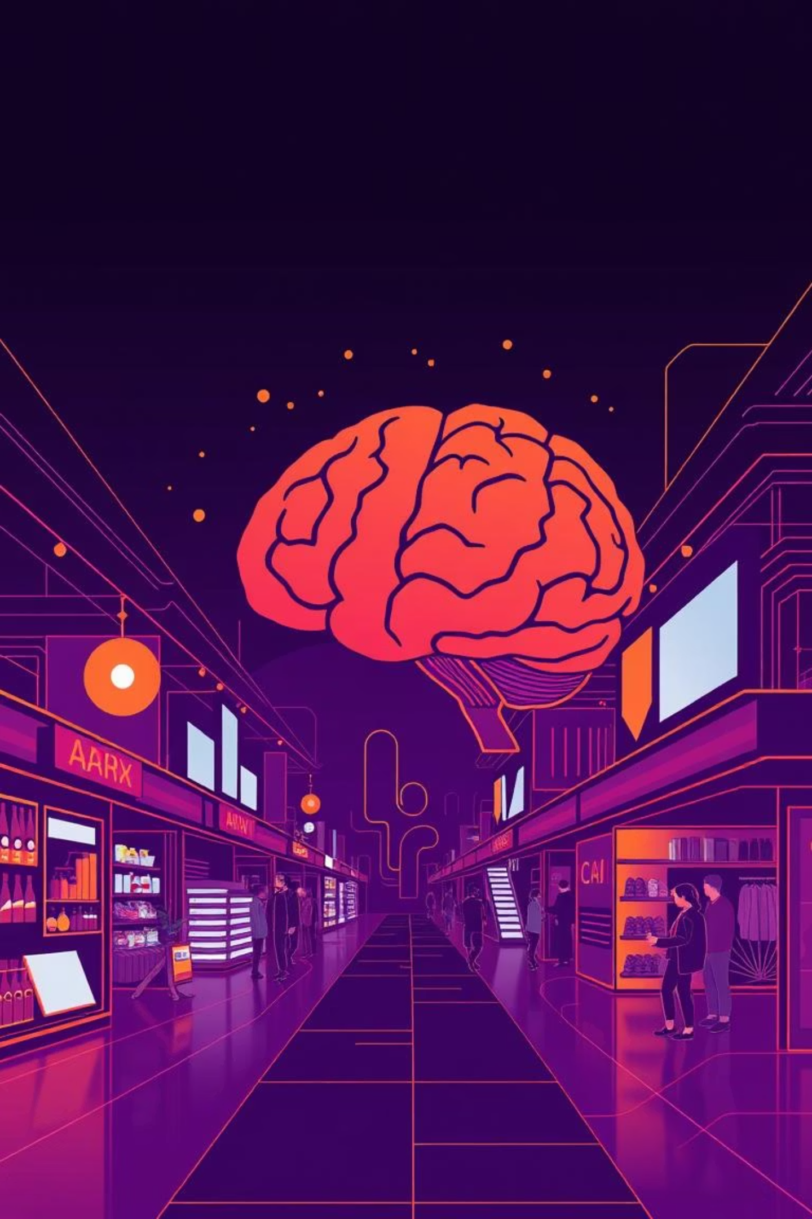

Pixsort- AI powered image management and marketplace.

Slide 2
Meet the Innovators
Our Team
Sahil Sharma
Ansh Soni
Hitesh Jangir
Aayush Pandya
Enrollment No: 23002171410056
Enrollment No: 23002171410059
Enrollment No: 23002171310057
Enrollment No: 23002171310001
Roll No: 17
Roll No: 15
Roll No: 8
Roll No: 30
Branch: CSIT
Branch: CSIT
Branch: CST
Branch: CST
Division: D1
Division: D1
Division: D1
Division: D1

Slide 3

Introducing Pixsort Marketplace
Pixsort Marketplace is a groundbreaking web application designed to revolutionize how creators manage and monetize their digital images. It offers a seamless platform for uploading, categorizing, and selling visual content, empowering artists and photographers worldwide.
At its heart, Pixsort features an advanced AI-powered categorization system. This intelligent core automatically analyzes and tags images with remarkable precision, ensuring content is not only easily discoverable but also perfectly matched to buyer needs within the marketplace.

Slide 4
Technology Stack & Architecture
1
2
Frontend
Backend & API
Built with React for dynamic user interfaces, styled with CSS. React Router handles intuitive navigation, and Axios manages efficient API requests.
Developed entirely in Python using the robust Django framework. Our API is powered by the Django REST Framework, ensuring secure and scalable data exchange.
3
4
Database & Storage
AI & Machine Learning
MongoDB serves as our flexible NoSQL database, integrated via the Djongo connector. Image metadata is stored here, while the actual image files reside securely on the server.
Seamlessly integrated into Django, our AI service uses YOLOv8 for precise object detection and ResNet for comprehensive image classification. NLTK and WordNet provide semantic depth for categorization.

Slide 5





Core Features & Workflow
Secure User Authentication
Robust registration and login for a personalized experience using JWT.
AI-Powered Image Upload & Categorization
Upload images and then our AI instantly analyzes and assigns detailed and general categories, enriching discoverability.
Personalized Image Gallery
View and manage all uploaded and purchased images, with options to list content for sale.
Dynamic Image Marketplace
Explore a vast public marketplace to discover and purchase unique images from a diverse community of creators.
Simulated Payment System
Experience a seamless, payment process to complete image purchases.

Slide 6

Future Vision & Conclusion
Future Scope
Our vision for Pixsort Marketplace includes:
Implementing advanced search filters for precise image discovery.
Introducing rich user profiles for creators to showcase their work and manage galleries.
Developing a robust user rating and review system for transparency and quality.
Expanding beyond still images to include AI-powered video categorization and sales.

Slide 7
Thank You!
Questions? We're ready to discuss the future of image marketplaces.

